Slide 2
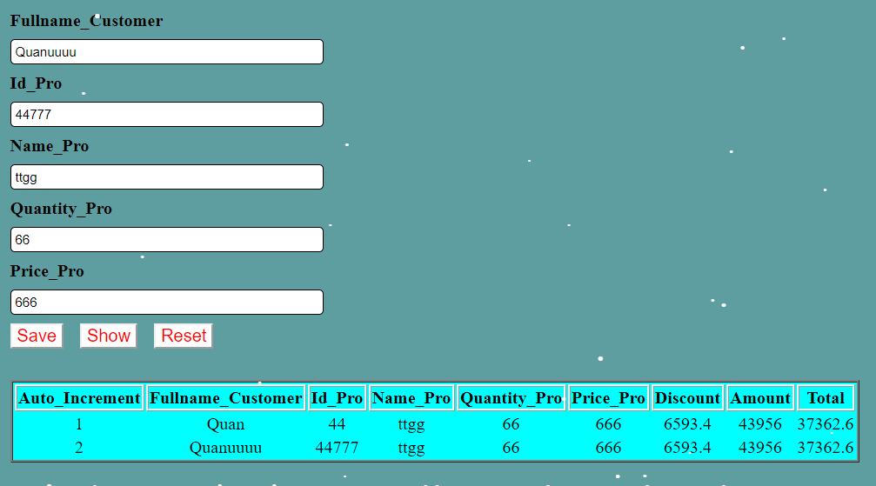
Activity

Slide 3
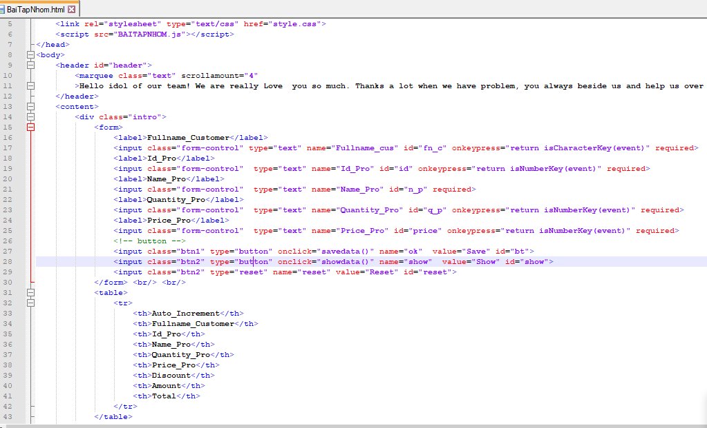
Notes:
<!DOCTYPE html>
<html>
<head>
<title>Caculater</title>
<link rel="stylesheet" type="text/css" href="style.css">
<script src="BAITAPNHOM.js"></script>
</head>
<body>
<header id="header">
<marquee class="text" scrollamount="4"
>Hello idol of our team! We are really Love you so much. Thanks a lot when we have problem, you always beside us and help us over any difficult. We<3U</marquee>
</header>
<content>
<div class="intro">
<form>
<label>Fullname_Customer</label>
<input class="form-control" type="text" name="Fullname_cus" id="fn_c" onkeypress="return isCharacterKey(event)" required>
<label>Id_Pro</label>
<input class="form-control" type="text" name="Id_Pro" id="id" onkeypress="return isNumberKey(event)" required>
<label>Name_Pro</label>
<input class="form-control" type="text" name="Name_Pro" id="n_p" required>
<label>Quantity_Pro</label>
<input class="form-control" type="text" name="Quantity_Pro" id="q_p" onkeypress="return isNumberKey(event)" required>
<label>Price_Pro</label>
<input class="form-control" type="text" name="Price_Pro" id="price" onkeypress="return isNumberKey(event)" required>
<!-- button -->
<input class="btn1" type="button" onclick="savedata()" name="ok" value="Save" id="bt">
<input class="btn2" type="button" onclick="showdata()" name="show" value="Show" id="show">
<input class="btn2" type="reset" name="reset" value="Reset" id="reset">
</form> <br/> <br/>
<table>
<tr>
<th>Auto_Increment</th>
<th>Fullname_Customer</th>
<th>Id_Pro</th>
<th>Name_Pro</th>
<th>Quantity_Pro</th>
<th>Price_Pro</th>
<th>Discount</th>
<th>Amount</th>
<th>Total</th>
</tr>
</table>
</div>
</content>
<script type="text/javascript" src="https://forum.vietdesigner.net/data/codes/snowstorm.js"></script>
</body>
</html>

Slide 4
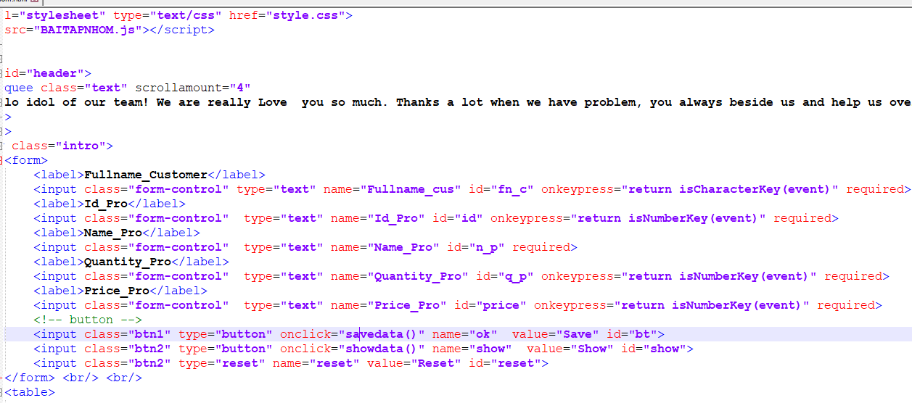

Slide 5
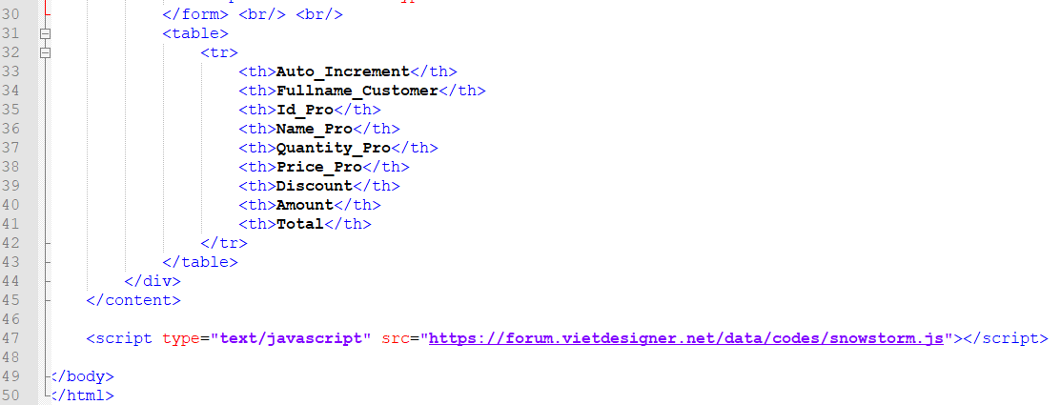

Slide 6
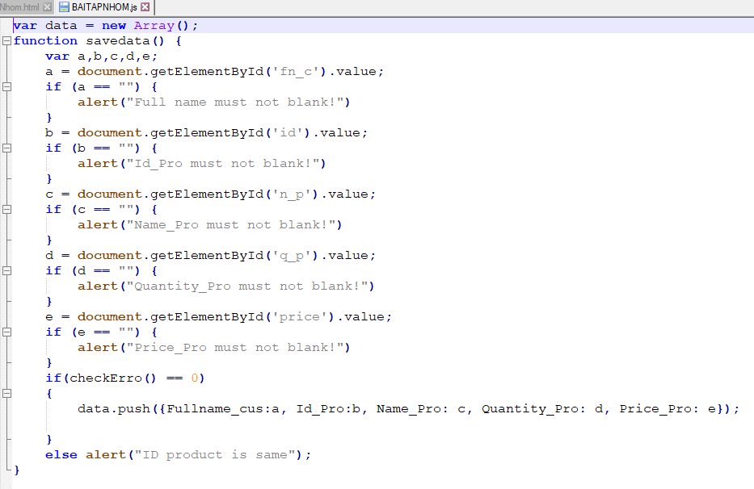

Slide 7
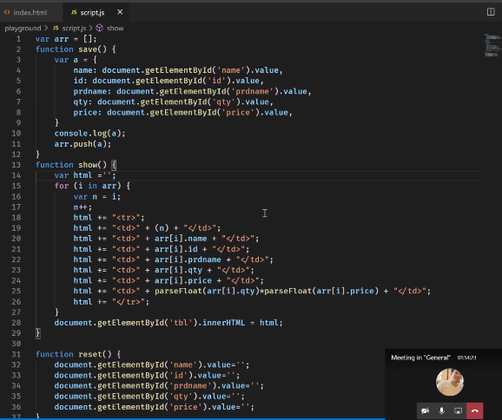

Slide 8
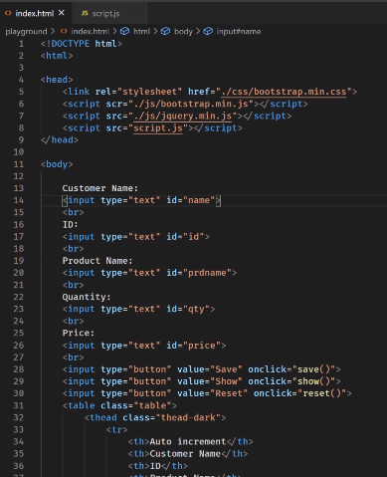

Slide 9
